Slide 1
Airline Planning
Notes:
This course template contains 2 slide masters that contain a number of template slides for you to use as background.
To use a certain background for your slide, select slide and from the shortcut menu, select Select Layout. Select a layout suitable for the content. The slide is updated. Make some adjustments, but make sure not to modify header type or colour.
Dummy text is within <xxx>.
For <version of product>: Example: for version 22 of Crew Tracking.

Slide 2
Teacher presentation Oscar Rodriguez
Notes:
Possibly hide this slide and replace with your personal teacher presentation slide, or show it separately.

Slide 3

Practical Details
To ensure a good learning environment, we appreciate that:
mobiles phones are turned off (or kept on silence)
phone calls are taken outside the training room
internet browsing, typing e-mails etc. is done on breaks
Practical information:
course hours are 9:00 to 17:00

Slide 4

Participants presentation
Name, company
Role
Experience
Your expectations
<Other>

Slide 5

Course goals
Give an understanding of:
Airline basics
Airline planning concepts
Airline terminology
Airline planning decisions
Crew & Fleet products
What Digital Aviation brings
Integrated Optimization
Airline Operating environment

Slide 6
Airline Basics
Notes:
Divider slide to introduce a summary on a (number of) topic(s). Numbering not mandatory.

Slide 7
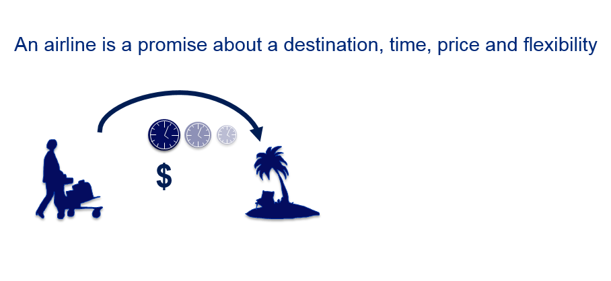
What is an Airline, really?

Slide 8
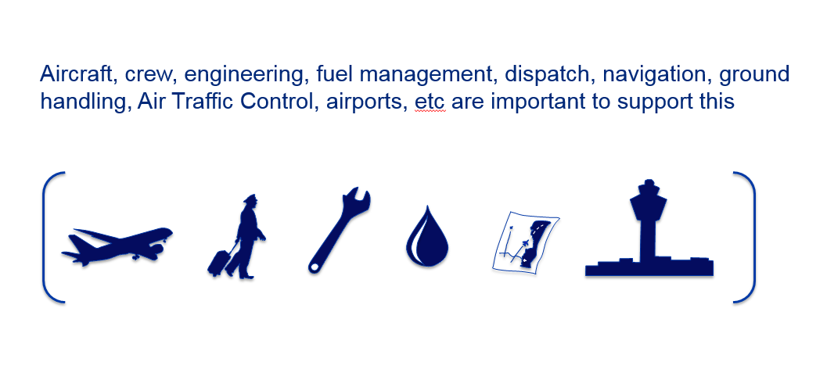
What is an Airline, really?

Slide 9
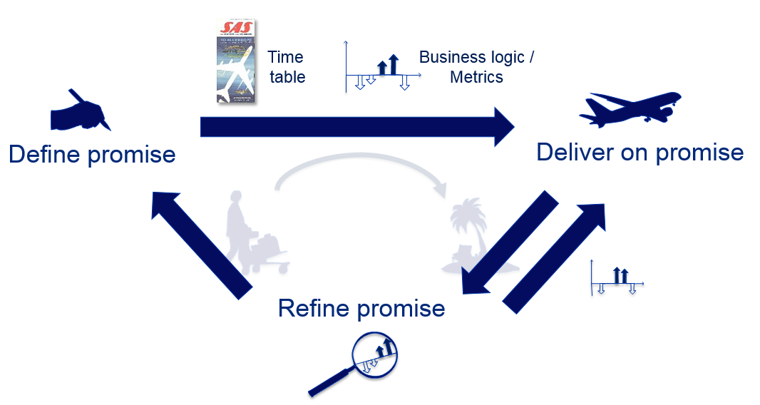
What is an Airline, really?

Slide 10
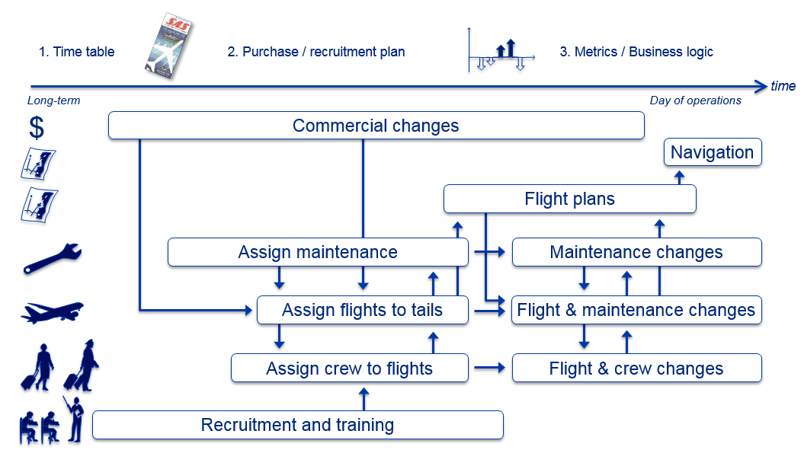
What is an Airline, really?

Slide 11
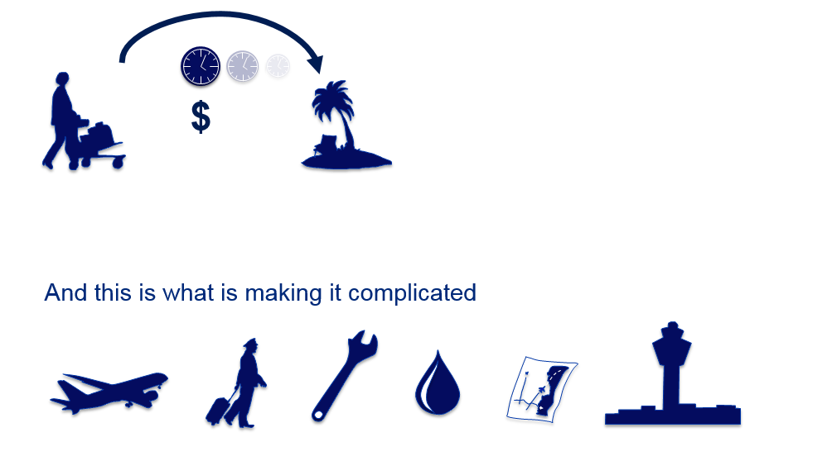
What is an Airline, really?

Slide 12
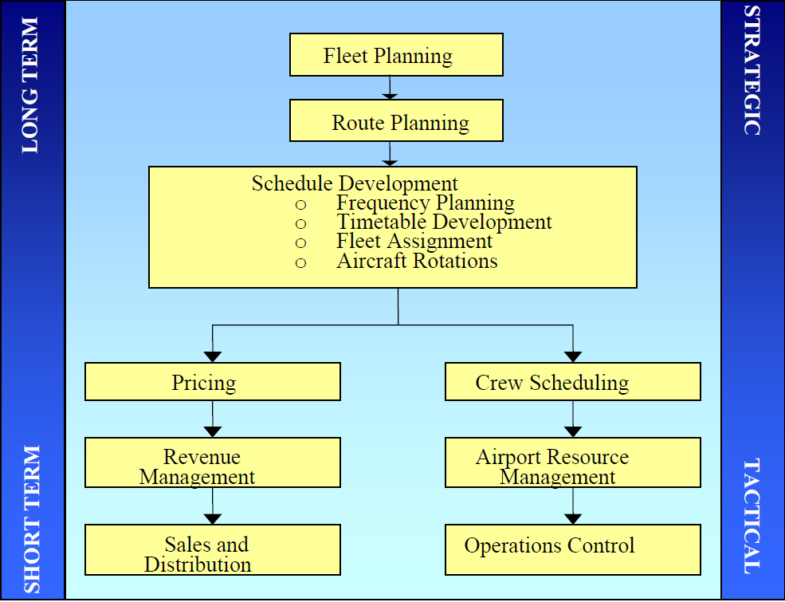
Airline Terminology
Time Horizon
Types of Decision

Slide 13
Airline Planning Decisions
1.FLEET PLANNING: What aircraft to acquire/retire, when and how many?
2. ROUTE EVALUATION: What network structure to operate and city-pairs to be served?
3. SCHEDULE DEVELOPMENT: How often, at what times and with which aircraft on each route?
4. PRICING: What products, fares and restrictions for each O-D market?
5. REVENUE MANAGEMENT: How many bookings to accept, by type of fare, to maximize revenue on each flight and over the network?

Slide 14
1. FLEET PLANNING
Long-term strategic decision for an airline:
–Affects financial position, operating costs, and especially the ability to serve specific routes.
Fleet planning is an optimal staging problem:
–Number and type of aircraft required
–Timing of deliveries and retirement of existing fleet
–Tremendous uncertainty about future conditions
Aircraft evaluation criteria for airlines include:
–Technical and performance characteristics
–Economics of operations and revenue generation
–Marketing and environmental issues
–Political and international trade concerns
Notes:
preocupaciones políticas y comerciales internacionales

Slide 15
2.ROUTE PLANNING
Given a fleet, selection of routes to be flown
Economic considerations dominate :
–Forecasts of potential demand and revenues
–Airline’s market share of total forecast demand
–Opportunity cost of using aircraft on this route
–Network implications for costs, revenues and “profit”
Practical considerations just as important:
–Aircraft with adequate range and proper capacity
–Performance and operating cost characteristics
–Operational constraints and aircraft/crew rotation issues
–Regulations and limited airport slots

Slide 16
3. SCHEDULE DEVELOPMENT
Involves several interrelated decisions, which to date have not been fully integrated:
Frequency Planning: Number of departures to be offered on each route, non-stop versus multi-stop
Timetable Development: Flight departure and arrival times, including connections at airline hubs
Fleet Assignment: Aircraft type for each flight, based on demand and operating cost estimates
Aircraft Rotation Planning: Links consecutive flights to ensure balanced aircraft flows on the network.

Slide 17
4. PRICING DECISIONS
“Differential pricing” by airlines is universal:
–Classes of service (First, Business, Coach)
–Different “fare products” within the coach cabin, with different restrictions, at different prices
–Virtually every airline in the world offers multiple price points (even low-fare carriers with “simplified” fare structures)
Economic trade-off in pricing decisions:
–Stimulation of new demand; increased market share for airline
–Diversion of existing demand to lower fares; reduced revenues
–Recent pricing difficulties of network airlines due in part to greater diversion of revenues than stimulation of demand
Notes:
La compensación económica en las decisiones de fijación de precios:
Diversificación De la demanda existente para la reducción de costes; reducción de los ingresos
dificultades de fijación de precios recientes de las aerolíneas de red debido en parte a una mayor desviación de los ingresos que la estimulación de la demanda

Slide 18
5. REVENUE MANAGEMENT
“Inventory control” for airlines:
–Given a scheduled flight, capacity and prices, how many bookings to accept by fare type
–Objective is to maximize revenue --fill each seat with highest possible revenue
Computerized RM systems used by airlines to increase revenues by 4-6%:
–Generate forecasts by flight date and fare class
–Optimize seat allocations to different fare classes
–Overbooking models to minimize costs of denied boardings and “spoilage”
Notes:
Manejo d eigresos
Generar previsiones de la fecha de vuelo y clase de tarifa
ubicación de la localidad -Optimizar a diferentes clases de tarifas
-Modelos de sobrereservación para reducir al mínimo los costos de embarques denegados y "el deterioro

Slide 19
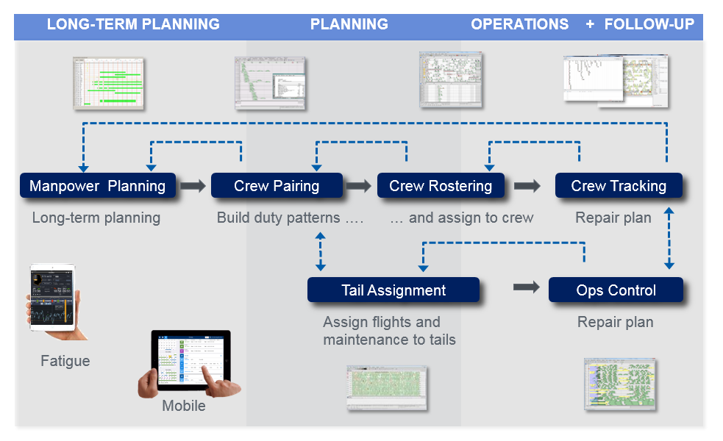
Crew & Fleet Products

Slide 20
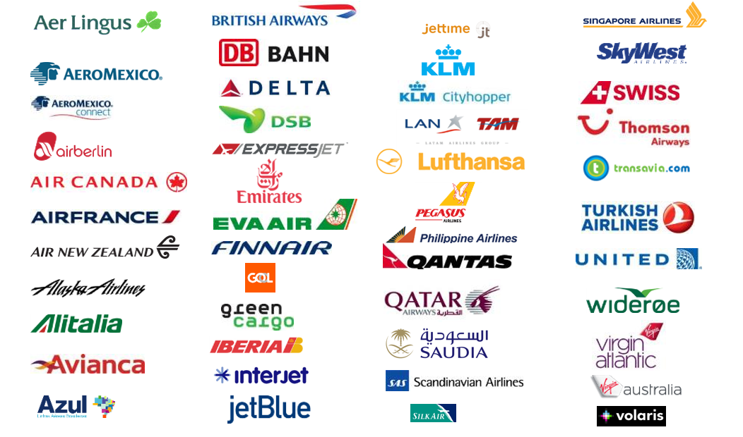
Crew & Fleet Products

Slide 21
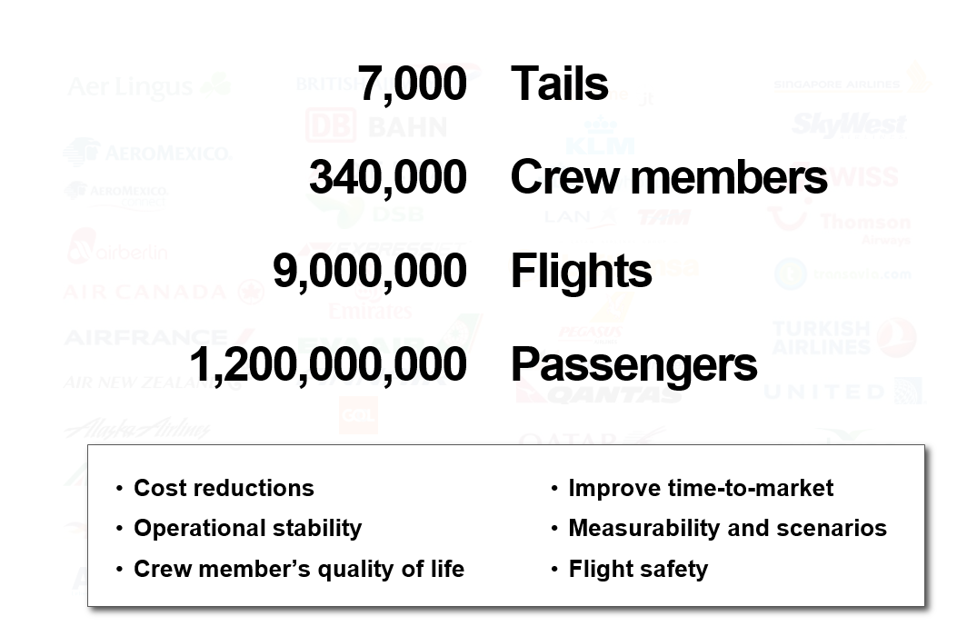
Crew & Fleet Products

Slide 22
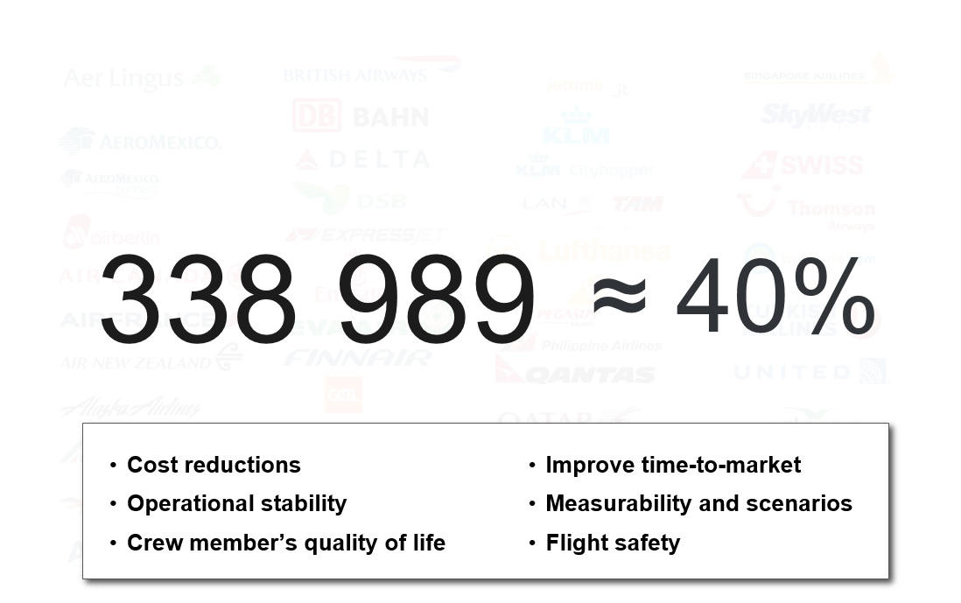
Crew & Fleet Products

Slide 23
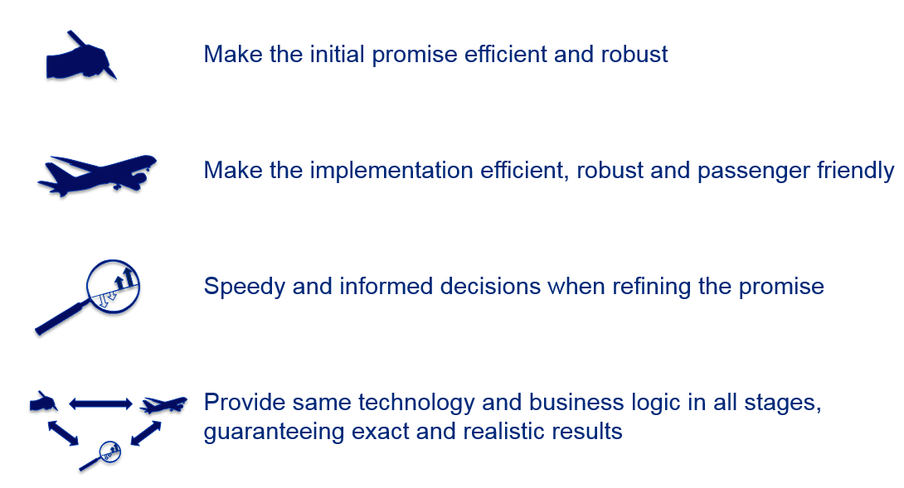
What Digital Aviation Brings

Slide 24
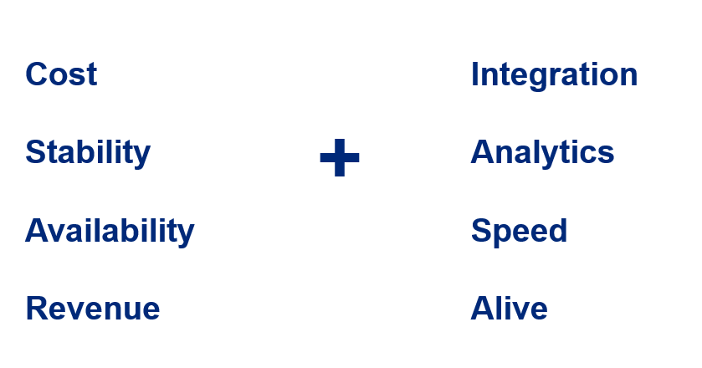
What Digital Aviation Brings
Notes:
vitalidad

Slide 25
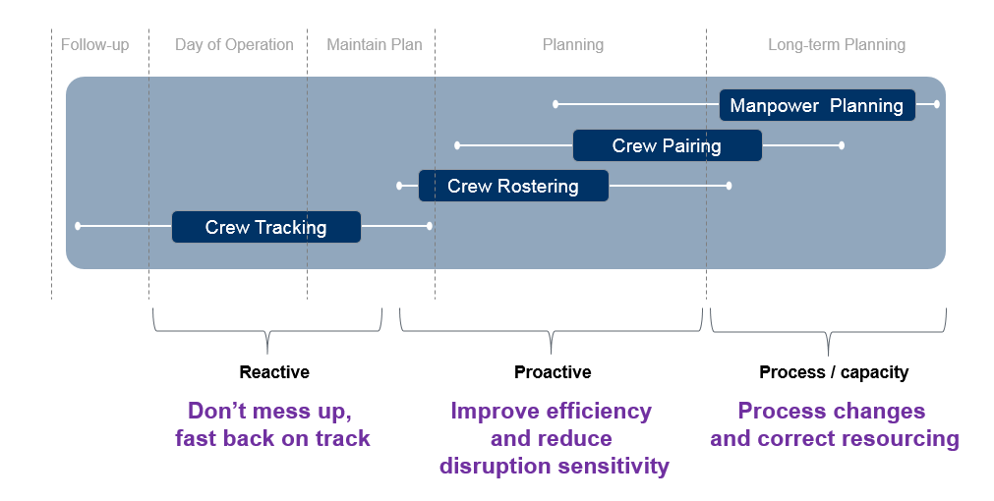
Integrated Optimization

Slide 26












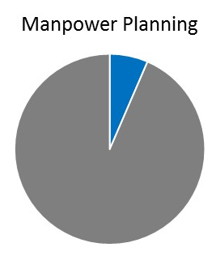
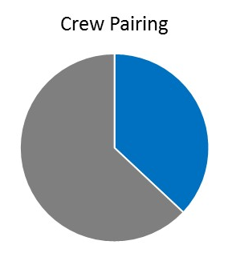



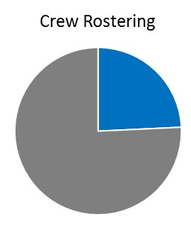
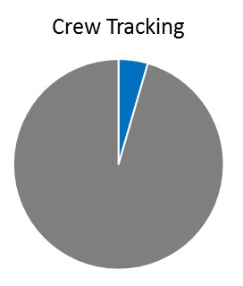






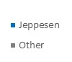











338 989 ≈ 40%
Crew members
Crew members
Crew members
Crew members
≈ 400 million $ in annual revenue remaining to sell

Slide 27
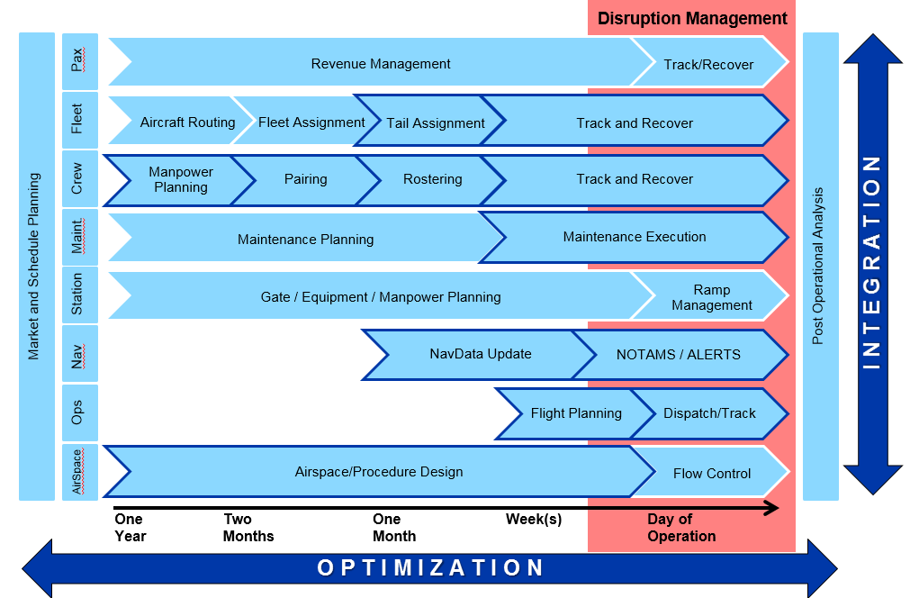
Airline Operating Environment
Current
Capability
Notes:
NOTAM or NoTAM es el acrónimo inglés de Notice To Airmen (Información para aviadores Los NOTAM se crean para alertar a los aviadores de cualquier clase de peligros en una ruta o en algún lugar en especial. Cuando un piloto entrega su plan de vuelo, el servicio de información de la autoridad correspondiente le comunica todos los NOTAM pertinentes.
Velocidades de crucero
Niveles de crucero
Ruta que ha de seguirse
Aeródromo de destino y duración total prevista
Aeródromos de alternativa
Autonomía
Número total de personas a bordo
Equipo de emergencia y de supervivencia

Slide 28
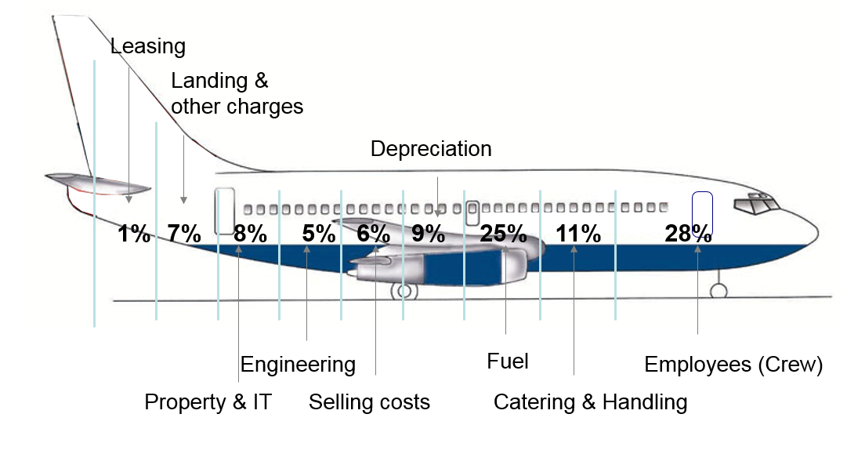
Airline Cost Break-down

Slide 29
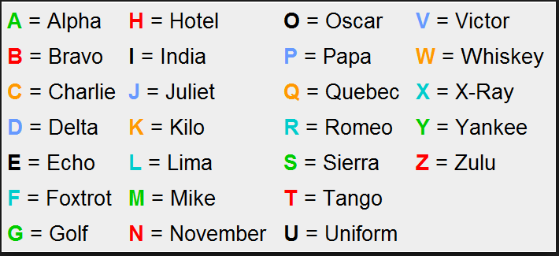
Aviation Alphabet
Changes with Spanish:
A = Alfa C = Coca E = Eco F = Fox J = Julieta M = Metro
N = Néctar U = Unión X = Extra

Slide 30
The end

